Slide 1
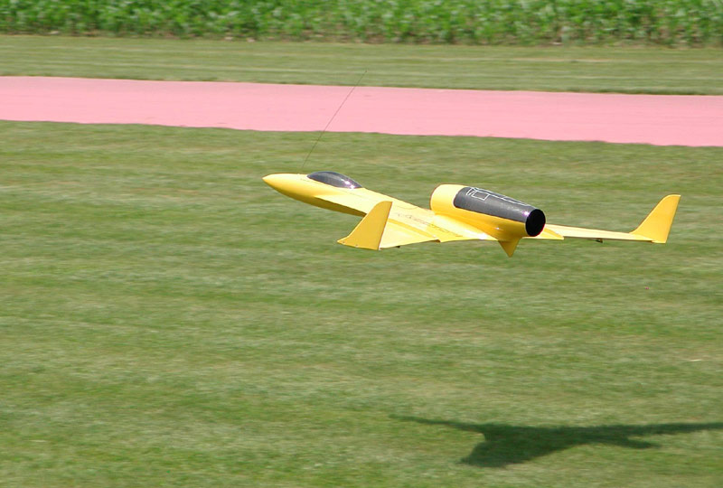
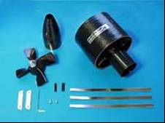
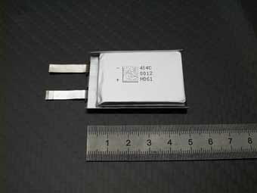
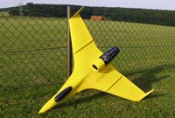
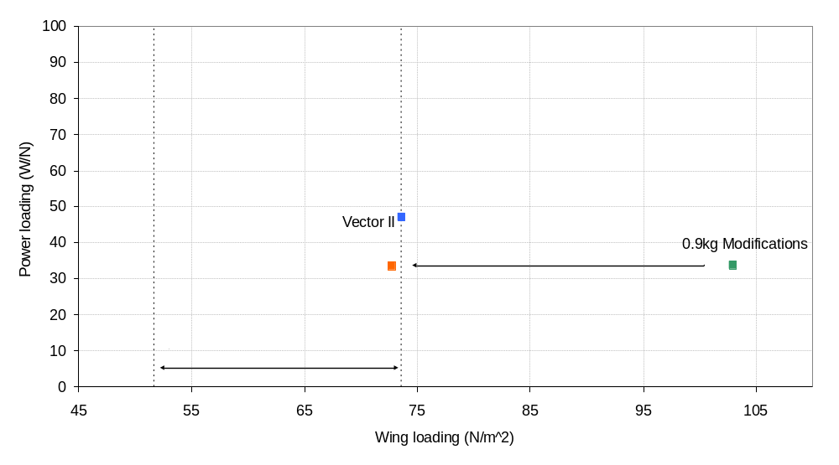
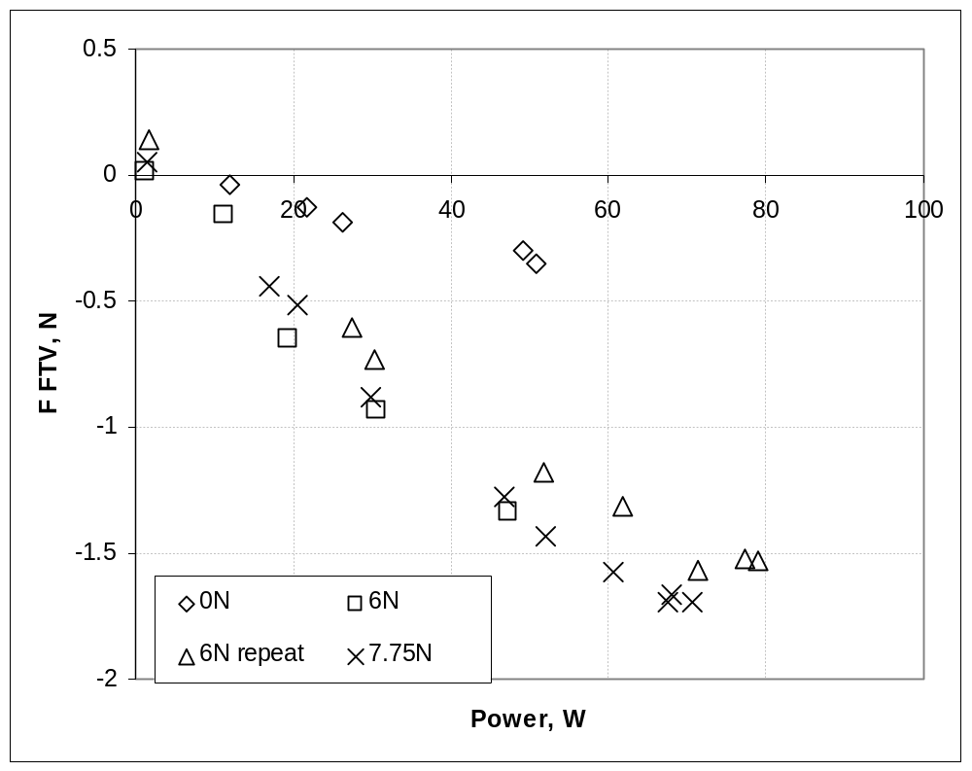
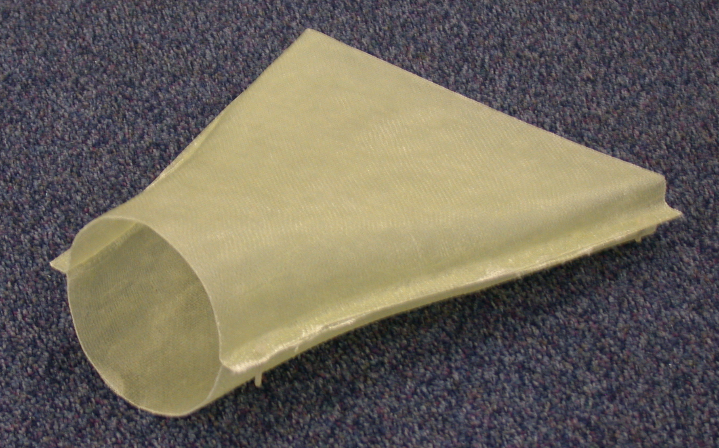

Fluidic thrust vectoring electric demonstrator
Introduction
The FTV demonstrator will be based on the Vector II EDF aircraft
An Electric ducted fan model allows similar characteristics to a jet engine to be evaluated without dealing with hot gas and related health safety issues
This aircraft has been selected as the most suitable candidate for the FTV modifications due to its prominently mounted engine and suitable flight characteristics
Vector II specification
Cruise Speed - 30m/s
Wing Span - 1.16m
Weight - 2.25Kg
EDF Propulsion
Power = 1.04KW
Flight Duration (battery life) = 8.5mins
Thrust = 22N
Propulsion Weight Total = 918g per EDF unit
Overall propulsive system thrust to weight of around 2
Sizing diagram
Simultaneous blowing
A
Secondary flow velocity < Primary flow velocity
Secondary flow entrained into primary, contributes to the overall thrust
B
Secondary flow velocity > Primary flow velocity
Primary flow entrained into the secondary flow and vectoring achieved
C
High aspect ratio nozzle
Primary flow
Resultant flow
Secondary flow
High AR required to achieve efficient vectoring
Pressure losses minimised by using constant area duct with divergence angle constraints
Design techniques:
  ProE
Manufacture techniques:
  Glass fibre/epoxy resin (Balsa/foam mould)
  Rapid prototyping ABS plastic
Experimental force data
Electric turbo-charger supplying secondary flow
Wemotec EDF providing primary flow
At cruise thrust of 6N, 1.5N of control force achievable using low power battery supply
F_{z}, N
F_{z}, N
Primary Thrust
Conclusion
The FTV seed corn demonstrator will be a modified off the shelf EDF kit implementing the FTV technologies to rapidly de-risk the fluidic flight controls.
Experience has been gained in designing and manufacturing axi-symmetric to high aspect ratio nozzles
The project has identified some implementation issues when applying bench top hardware to flight hardware
The project will highlight flight control issues concerning the use of an integrated propulsion and pitch control system
Name:- Ken Gill
Contact details:- Kenneth.gill@postgrad.manchester.ac.uk
Supervisor:- Dr W. J. Crowther University of Manchester School of Engineering
The University
of Manchester

